Slide 1
Android UI design
Jilin University

Slide 2
KMeans clustering parameter reference record
Adjustable parameters：n_clusters
 | n_clusters | Abnormity point
0 | 5 | 2815
1 | 50 | none
2 | 100 | none

Slide 3
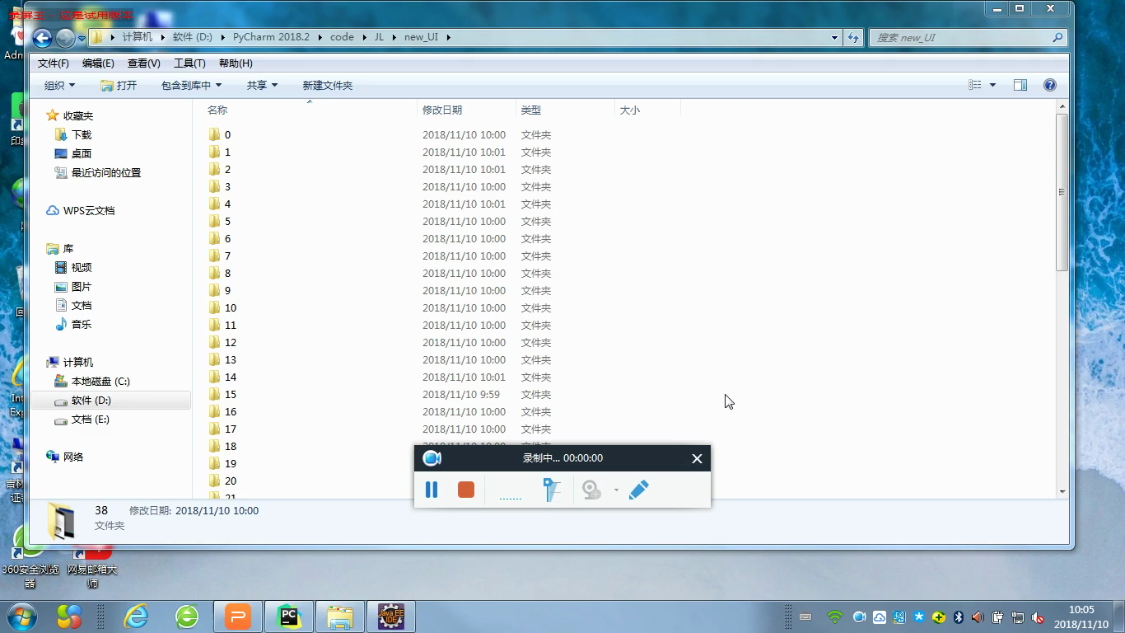
n_clusters=50

